Slide 1

Introduction to Robotics
CSE 461
Chapter 2: Lecture 5 (Kinematics)
Md Toki Tahmid
Lecturer, Dept. of Computer Science and Engineering
BRAC University

Slide 2
Today
Kinematics
Joints
D-H Parameters

Slide 3
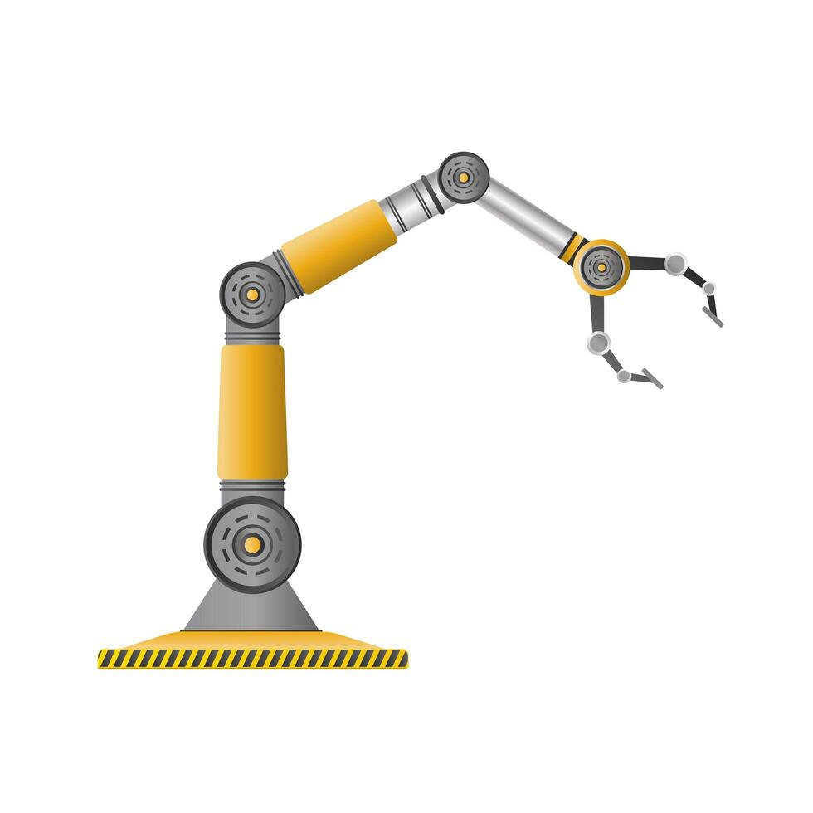

Slide 4
Kinematics
Robot arm kinematics deals with the analytical study of the geometry of motion of a robot arm with respect to a fixed reference coordinate system as a function of time without regard to the force/moments that cause the motion.
There are two problems related with robot arm kinematics.
Direct Kinematics
Inverse Kinematics

Slide 5
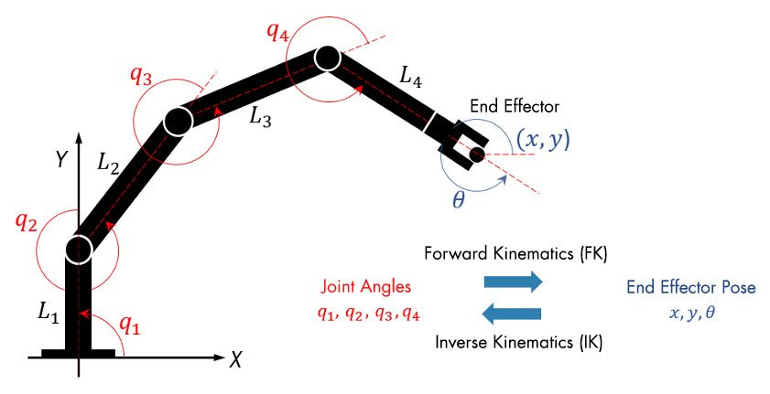

Slide 6
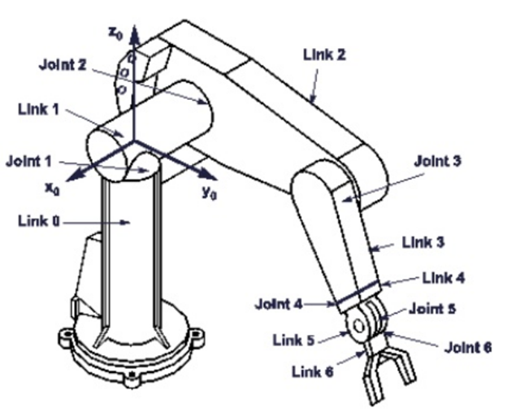
Degrees of Freedom
Degrees of Freedom (DoF)
General purpose robots: Possesses 6 dof.
Redundant robot: Possesses more than 6 dof.
Deficient robot : Possesses less than 6 dof.

Slide 7
Types of Joints
Prismatic Joint, P: Permits two paired elements to rotate with respect to each other about an axis that is defined by the geometry of the joint. It is sometimes called a sliding pair. It has 1-dof.
Revolute Joint, R: Permits two paired elements to rotate with respect to each other about an axis that is defined by the geometry of the joint. It is sometimes called a turning pair, a hinge or a pin point. It has 1-dof.

Slide 8
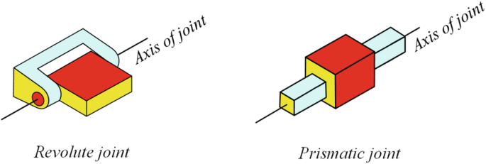

Slide 9
Types of Joints
Cylindrical Joint, C: Permits rotation about, and independent translation along an axis, that is defined by the geometry of the joint. I has 2-dof.
Helical Joint, H: Allowed two paired elements to rotate about, and translation along, an axis defined by the geometry of the joint. However, the translation is related to the rotation by the pitch of a screw. It has 1-dof.
Spherical Joint, S: Allows one element to rotate freely with respect to the other about the center of the sphere in all possible orientations. It has 3-dof.

Slide 10
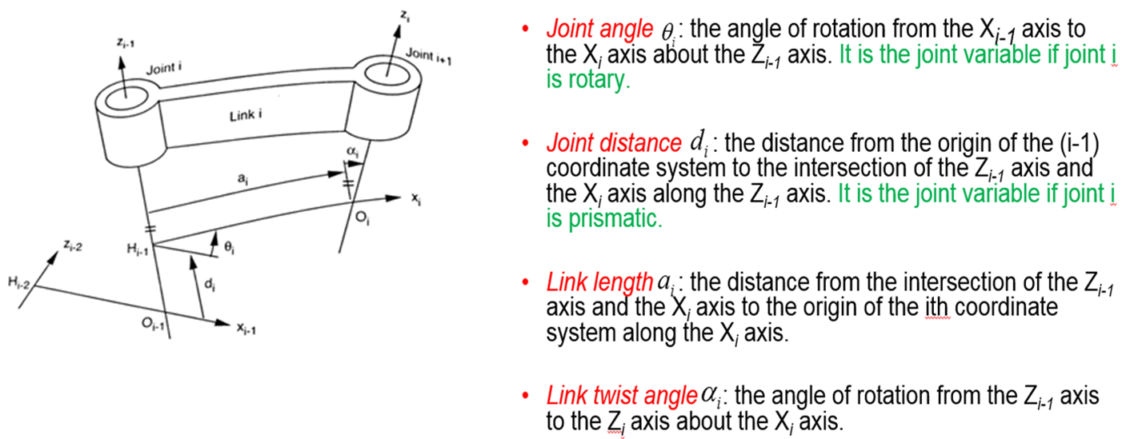
Link parameters and joint variables

Slide 11
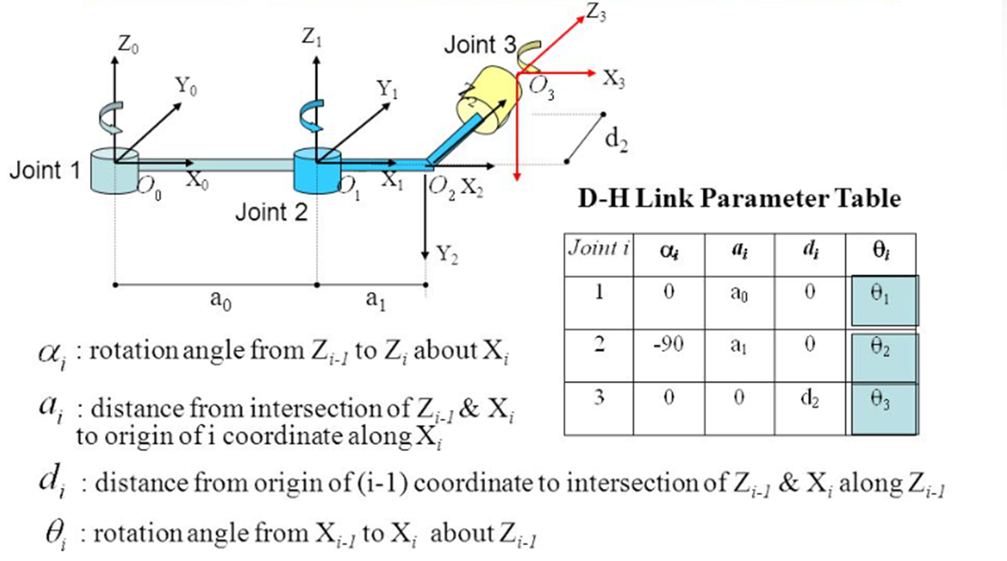
Link Parameters and Joint Variables example

Slide 12
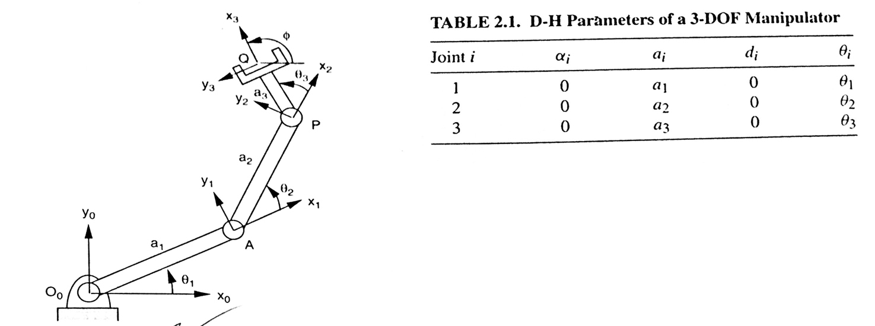
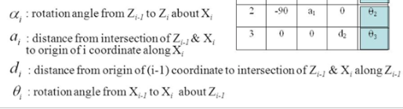
Parameters of a simply 3 DOF Manipulator

Slide 13
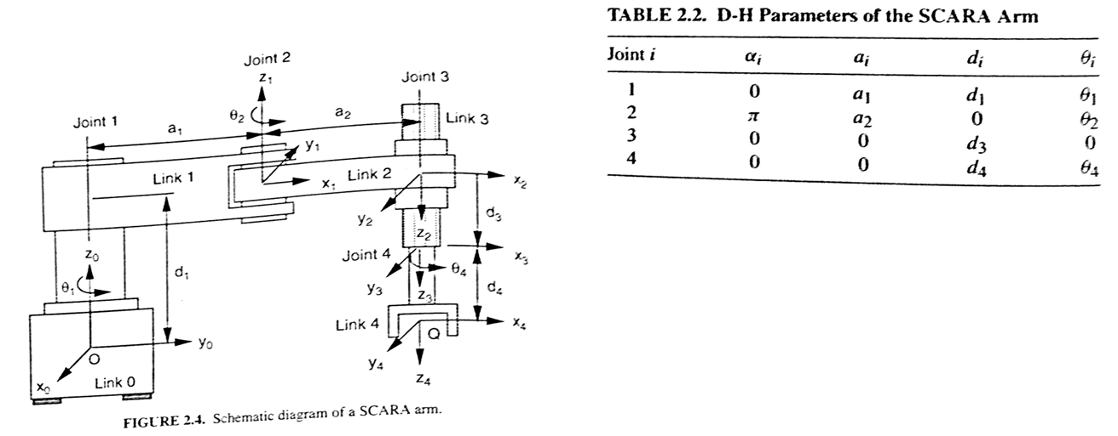
Parameters of SCARA Arm

Slide 14
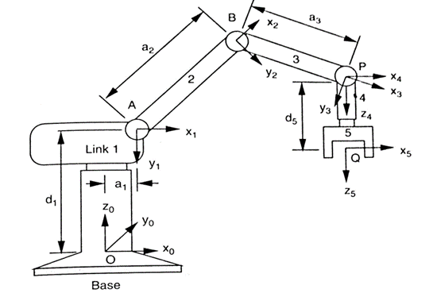
SCORBOT Robot (5 DOF Manipulator)

Slide 15
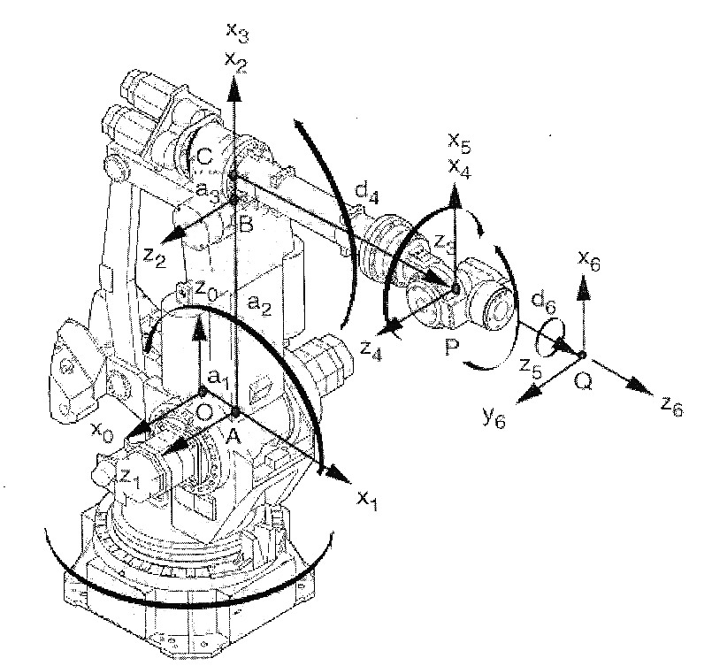

Slide 16
Thank You

